Slide 1
Game's name (TBA)
Level 4/5 Group 15
Connor Wilby
Callum Walsh
Macaulay Mills
Jake Seaman

Slide 2
Logline
The player must endure mundane everyday office tasks and allow their curiosity to take over and reveal the secret of his company.

Slide 3
Liberosis and Monachopsis
Liberosis
”The desire to care less about things”
Boring tasks
Greyscale, plain office cubicle
Monachopsis
“The subtle but persistent feeling of being out of place.”
Seeing things that are out of place
More and more incongruous items appear over the course of the game
Notes:
Boring tasks: designed to make the player not care about their “Job” and look for the elements that inspire the feeling of Monachopsis.
Greyscale, plain office cubicle:
Make the player notice the Monachopsis elements of the game feel much more out of place
Seeing things that are out of place:
these things will be colored to differentiate them from the environment, making them more interesting.
More and more incongruous items appear over the course of the game:
more of these items appear to the player until eventually they are surrounding them, always making it more difficult to concentrate on the task.

Slide 4
Target Audience
Gender: Male & Female
Age 16-26
General interests in:
Puzzles
Reading
Narrative driven video games.

Slide 5
Game mechanics
A 3D point and click game
Only movement is between Scenes
Notes:
Only movement is between Scenes:
To make the player feel confined and frustrated at their lack of choice in their location. Also encourages exploration of the scene that they have.
Can change scenes at any time:
However changes will only happen when the player has done enough tasks

Slide 6
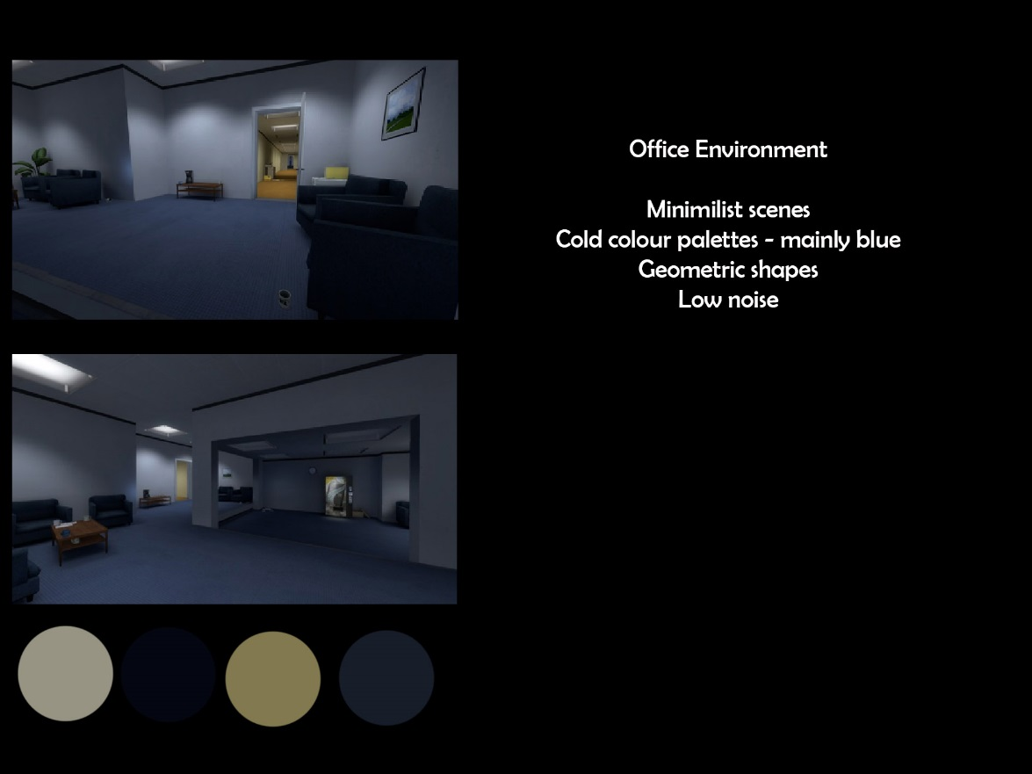
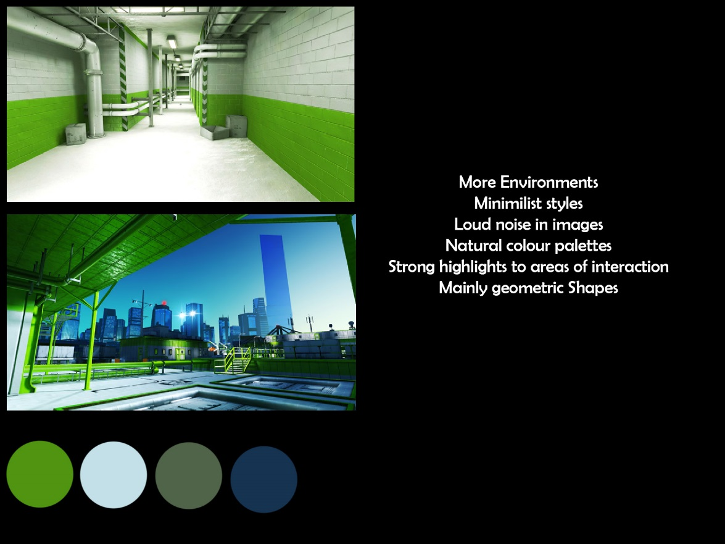
Art Research

Slide 7
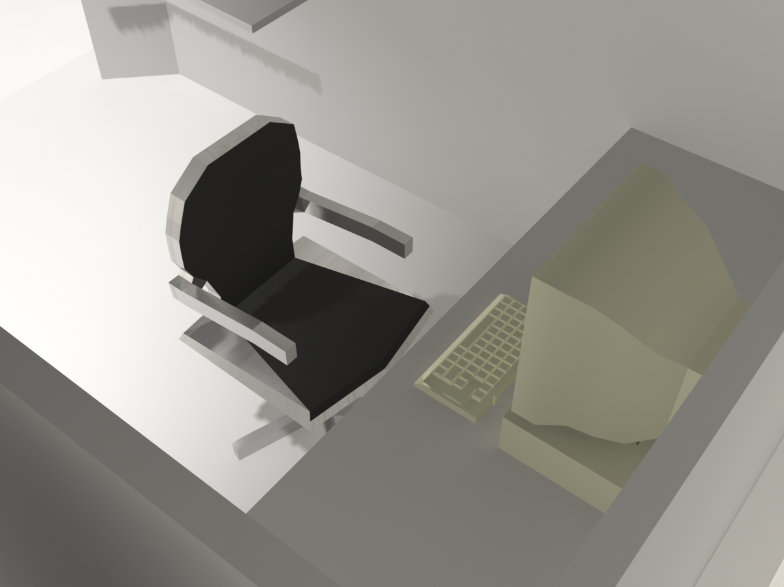
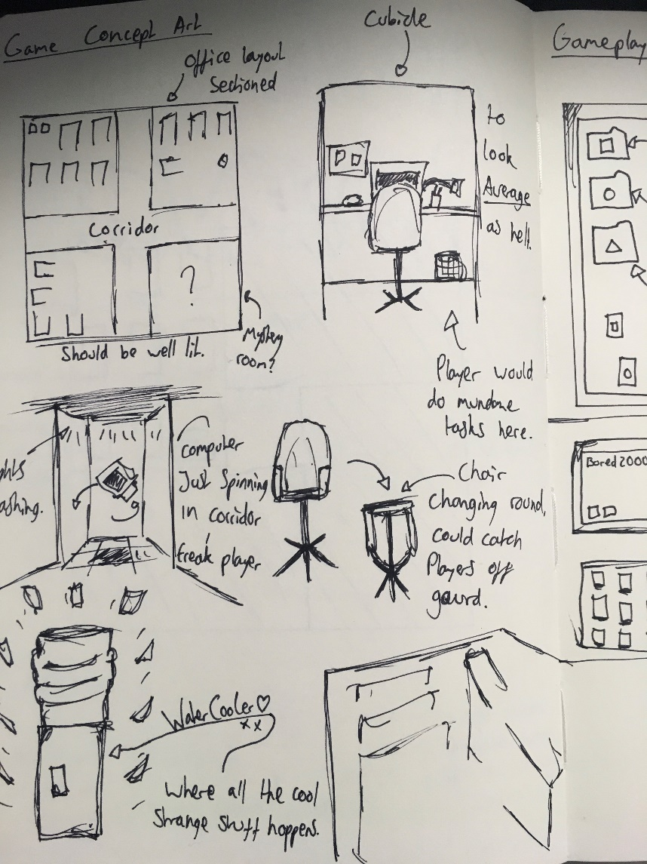
Concept art

Slide 8
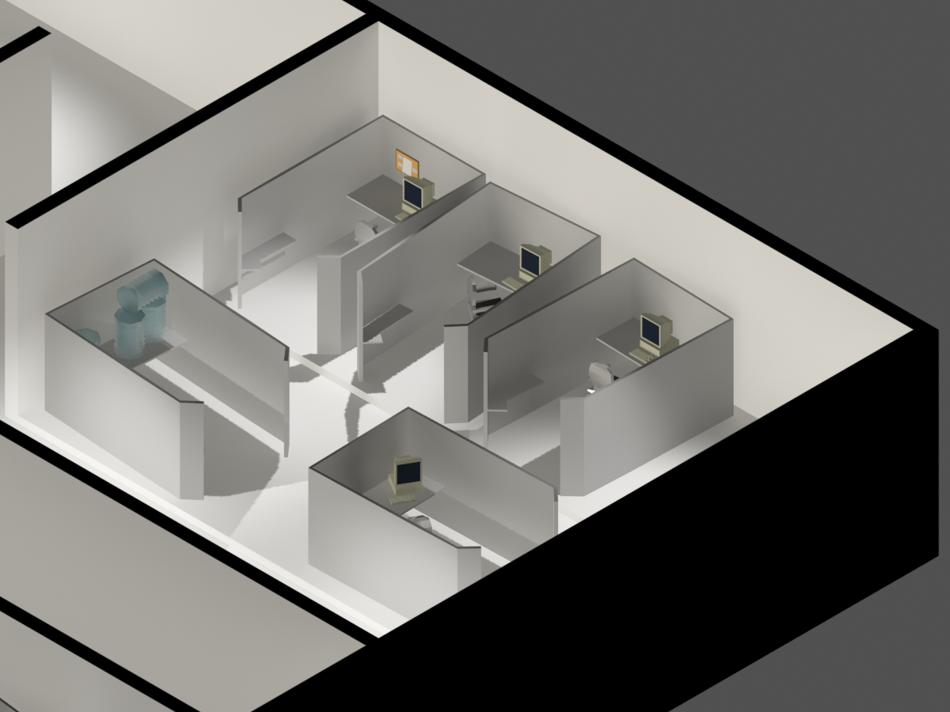
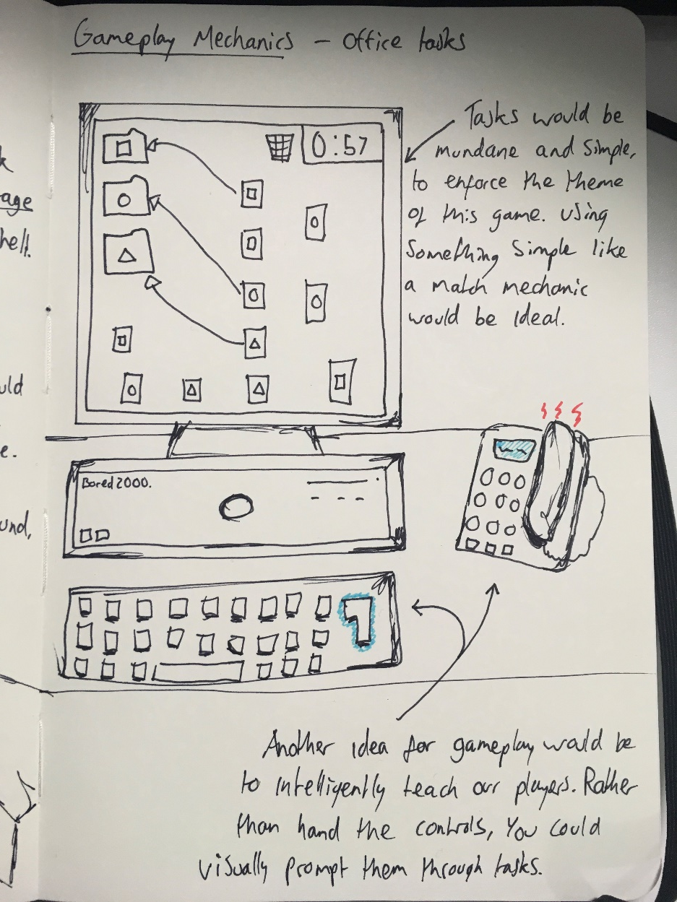
Concept art

Slide 9
Future plans
Design a number of tasks designed to make the player look for a distraction in their surroundings
Design a number of 3D areas for the player to interact with, including a cubicle and a staffroom/water cooler area
Design a story that is used to reward the player for doing their “boring” tasks and advance the story

Slide 10
Any questions?

